Slide 1

E6893 Big Data Analytics
Wildfire Exploratory Visualization and Cause Prediction
Project ID: 201912-2 Team Members (with UNI): Sidharth Bambah (sb4283) || Vedant Dave (vad2134)
Notes:
Both

Slide 2
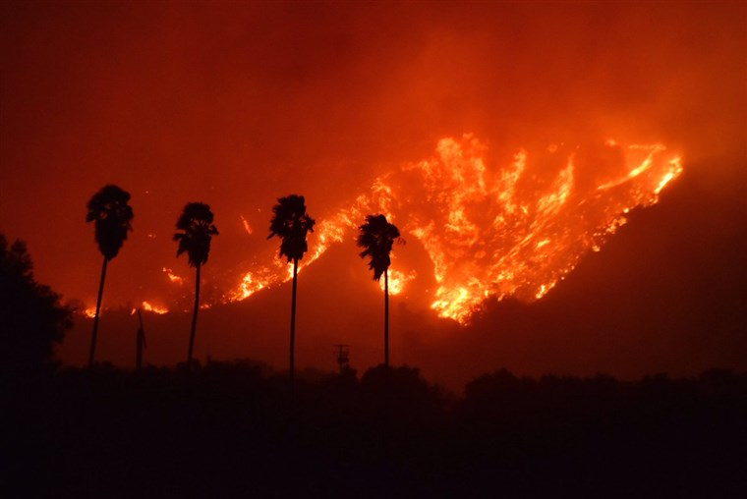
Introduction
Predict causes of fires for prevention and government spending allocation
Exploratory Analysis
Machine Learning
Notes:
Sid

Slide 3
Milestones
4 Nov
11 Nov
18 Nov
6 Dec
13 Dec
20 Dec
Final Submission
PART 1 - COMPLETE
PART 2 - COMPLETE
PART 3 - COMPLETE
Final Slides -
COMPLETE
-> Create machine learning models.
-> Determine model with best accuracy.
-> Make predictions for fire causes.
-> Web-app design and implementation.
-> Cloud deployment.
-> Code
-> Paper
->Video
-> Data processing
-> Build visualizations.
->Find important correlations.
-> Final slides and presentation
Notes:
Vedant

Slide 4
Dataset
1.88 Million US Wildfires (24 years of geo-referenced wildfire records)
License - CCO: Public Domain
Size : 759 MB
Spatial database of wildfires in the United States from 1992 to 2015
Originally generated to support the national Fire Program Analysis (FPA) system
Notes:
Vedant

Slide 5
Data Processing
Read SQLite database into CSV
Convert Julian to Gregorian date
Add day of week, month, and year
Uploaded subset to MongoDB cluster
Notes:
Sid

Slide 6
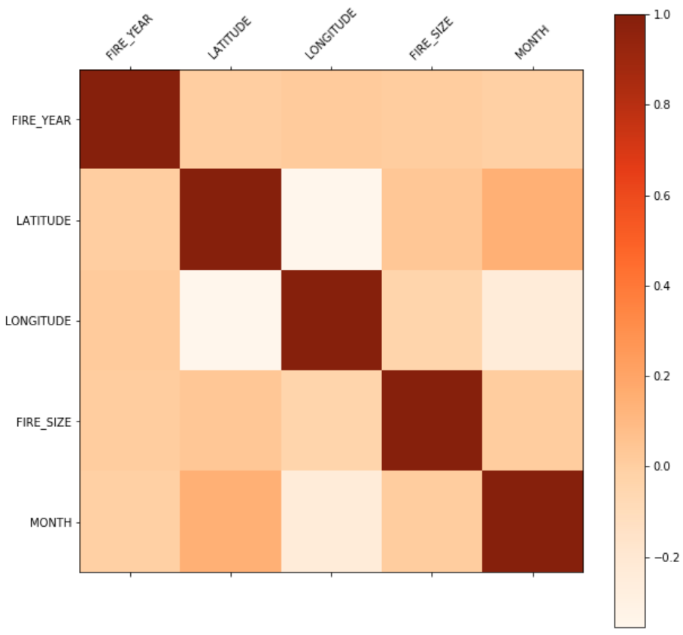
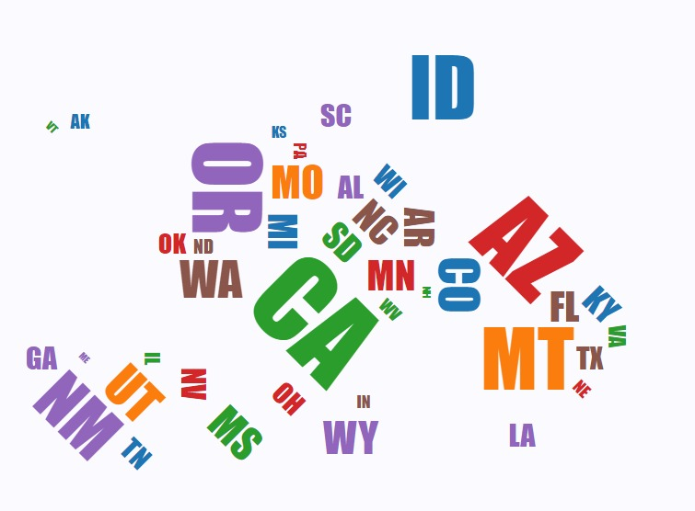
Exploratory Visualization
Notes:
Sid

Slide 7
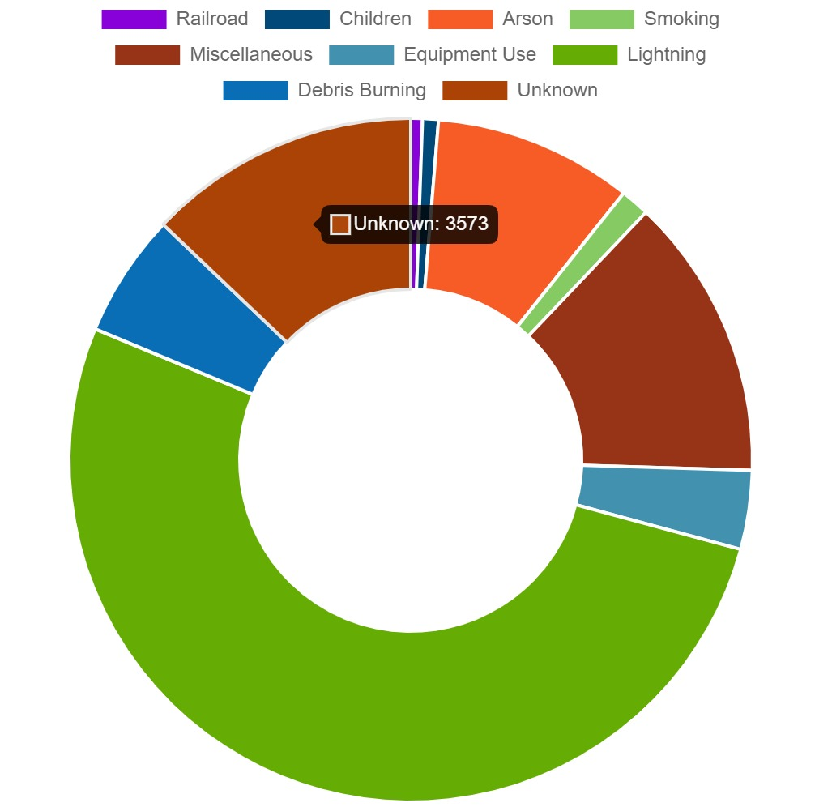
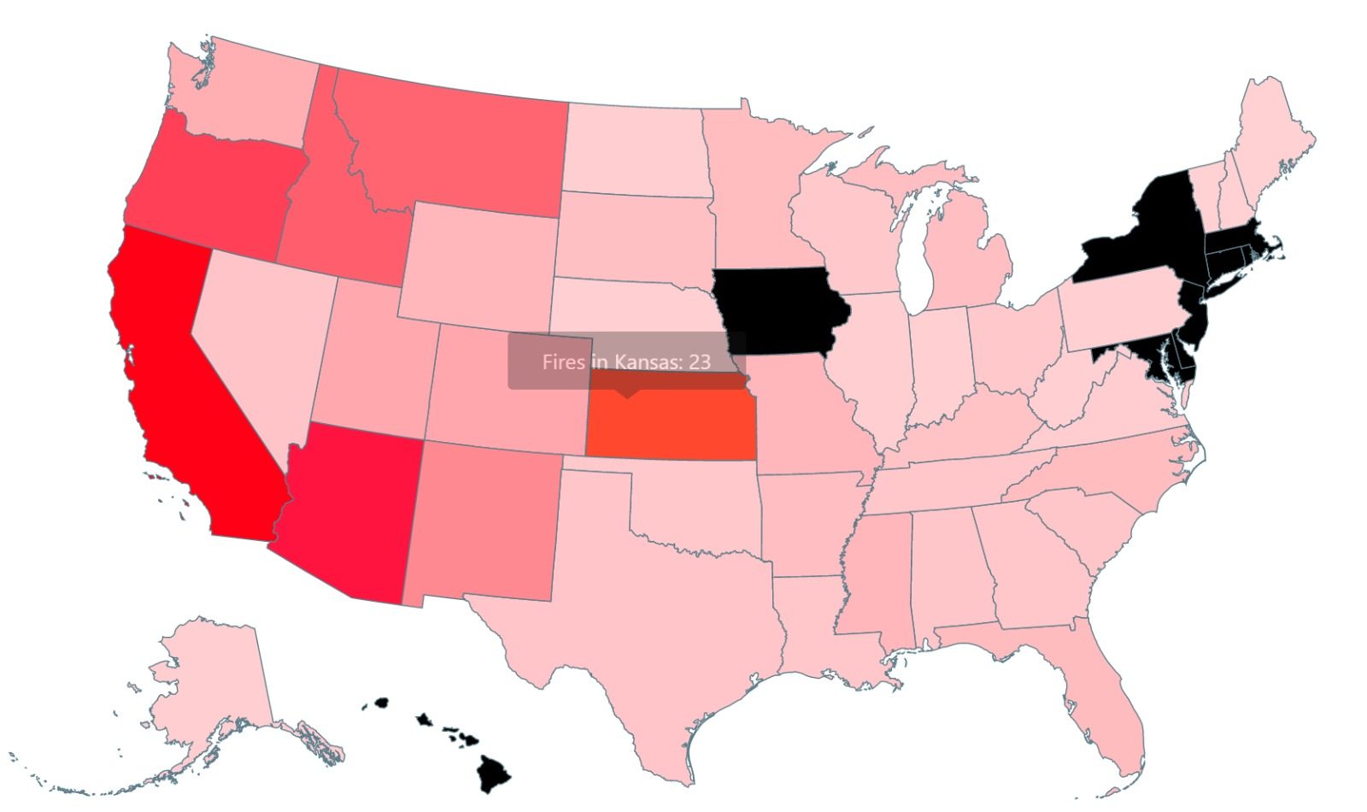
Exploratory Visualization
Notes:
Sid

Slide 8
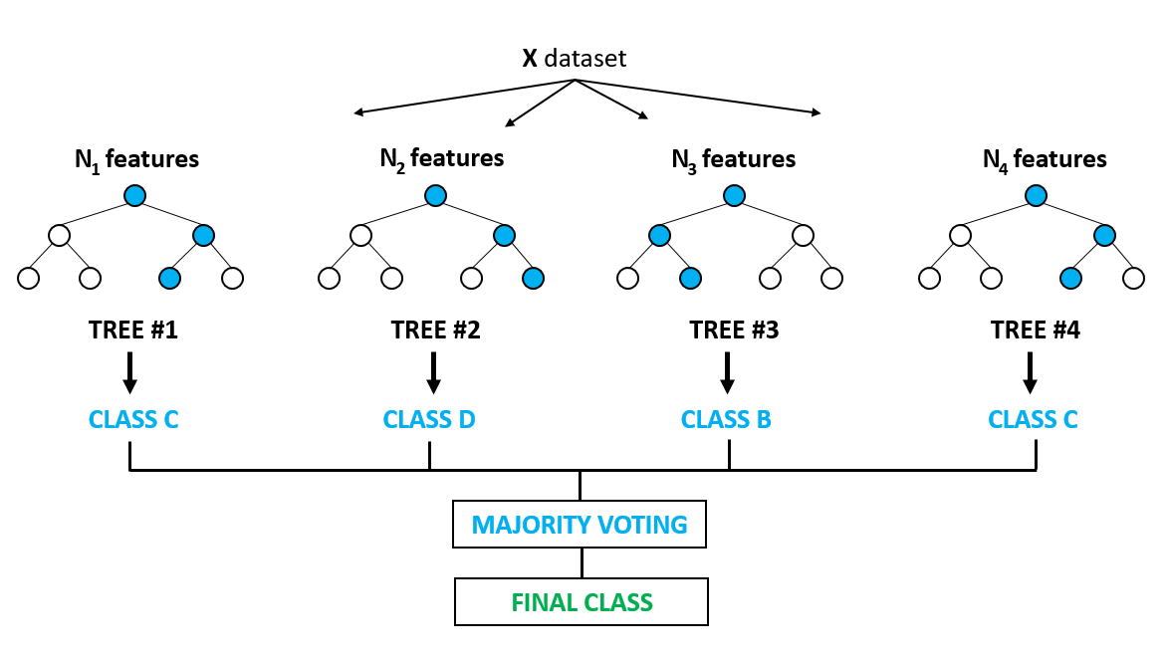
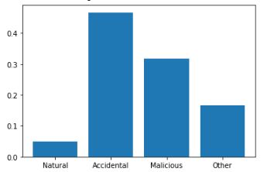
Machine Learning
Cleaned the data by eliminating un-important
Feature labels.
Applied Random Forest Classifier Machine
Learning algorithm after careful considera-
tion to predict the most probable cause of
the wildfire.
Grouped all the different causes of wildfires into 4 main categories:
1. Natural 2. Accidental 3. Malicious 4. Other
User inputs for the prediction of causes of wildfires:
1. Latitude 2. Longitude 3. Month 4. Day of Week
Notes:
Vedant

Slide 9
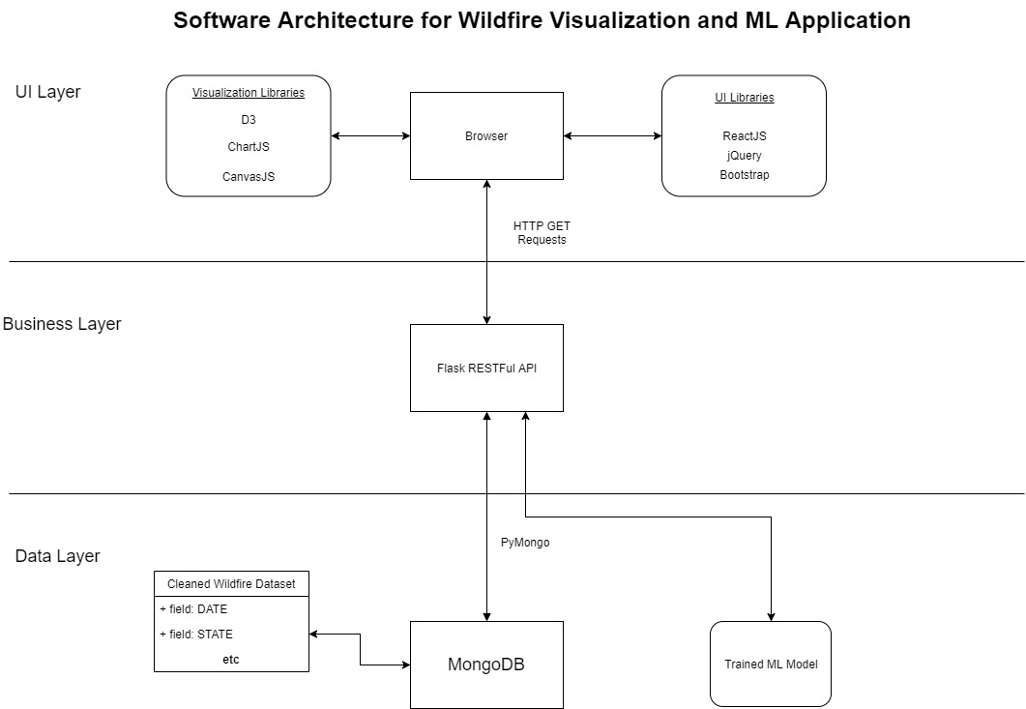
System Structure
Notes:
Sid

Slide 10
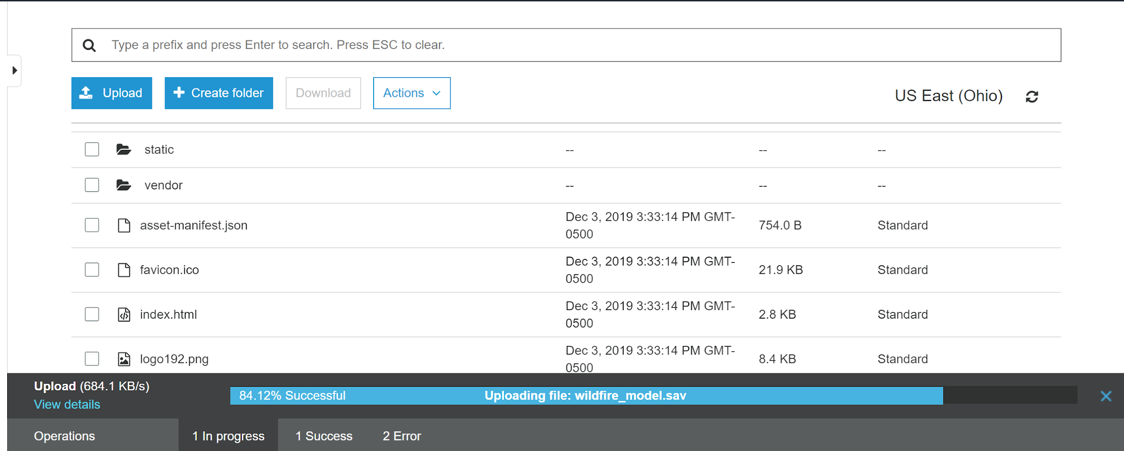
S3 Bucket
Notes:
Sid

Slide 11
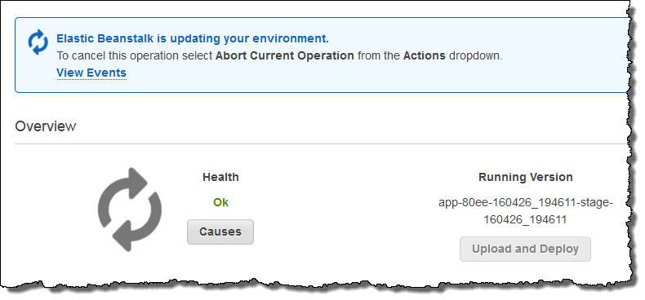
Elastic Beanstalk
Notes:
Sid

Slide 12
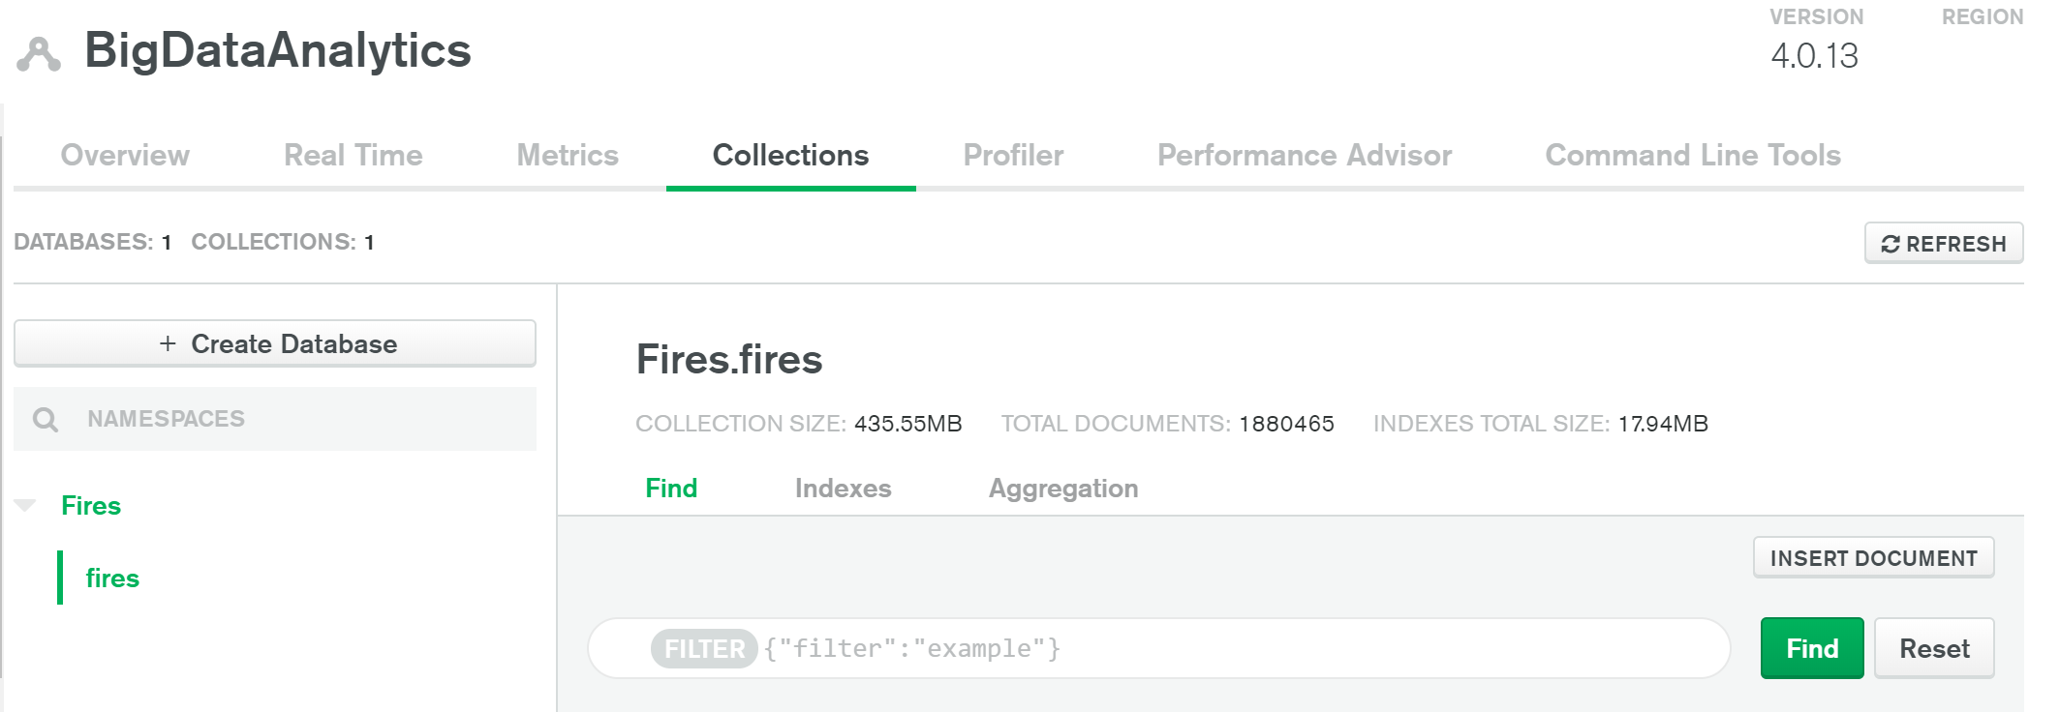
MongoDB
Notes:
Sid

Slide 13
Thank You!

Slide 14
Demo
Website: http://big-data-analytics-columbia.s3-website.us-east-2.amazonaws.com/
YouTube Video: https://youtu.be/aAZ1EnyyqEk
Notes:
Both
Add link to the youtube video

